Slide 1
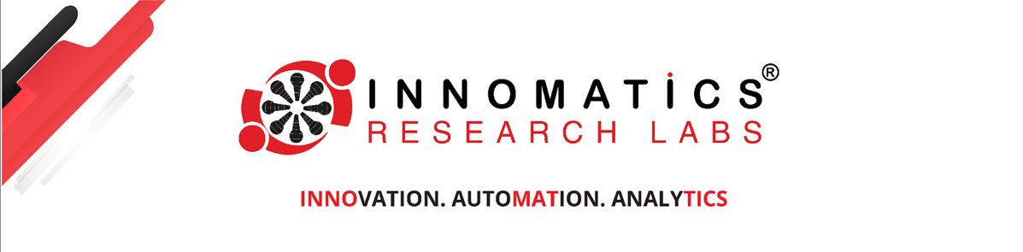

Project on
Hand Gesture Controlled YouTube Player
Presented by :
Name : Gounda Sohail Basha
Batch No : 436
Branch : Dilsukhnagar

Slide 2
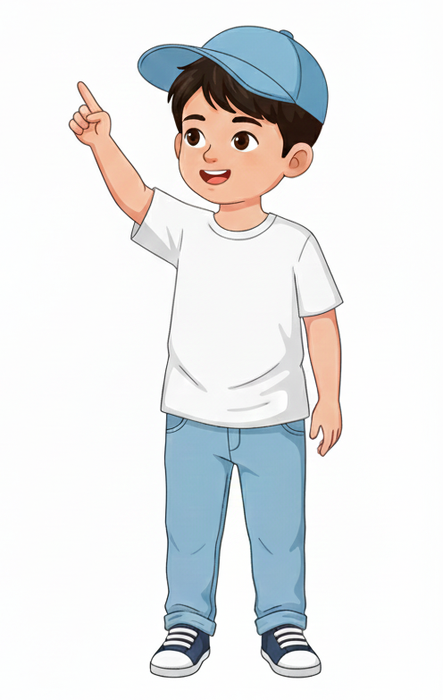
About me
I am Gounda Sohail Basha.
I completed my B.Tech in Mechanical Engineering from G Pulla Reddy College of Engineering(Kurnool).
Linkedin : www.linkedin.com/in/sohailbasha789
Github : https://github.com/Sohail-Basha

Slide 3

Agenda
Introduction
Problem Statement
Business Problem Statement
Project Objectives
System Architecture
Methodology
Hand Landmark Detection
Finger Counting Logic
Gesture-to-Action Mapping
Results
Future Enhancements
Conclusion
Q & A

Slide 4
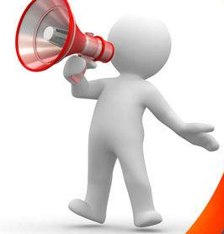
Introduction
Human-Computer Interaction is rapidly evolving toward more natural and contactless systems. Traditional media control relies on physical input devices such as keyboards, mice, or remote controls. However, advancements in Computer Vision now allow machines to interpret human gestures in real time using standard camera hardware.
This project presents a Hand Gesture Controlled YouTube Player built using OpenCV and MediaPipe. The system detects hand landmarks from live webcam input, interprets finger positions and gestures, and converts them into media control actions such as play, pause, forward, backward, and volume adjustment.
The objective is to demonstrate how real-time computer vision techniques can be applied to build intuitive, touchless control systems using low-cost hardware and efficient algorithms.

Slide 5
Problem Statement
Traditional media control systems rely heavily on physical devices such as keyboards, mice, or remote controls. These interaction methods are not always intuitive, hygienic, or accessible, especially in environments where touchless operation is preferred. Existing gesture-based systems often require specialized hardware or lack real-time responsiveness when implemented using standard webcams.
There is a need for a low-cost, real-time, and reliable hand gesture recognition system that can accurately interpret human gestures using a normal camera and translate them into meaningful media control actions such as play, pause, seek, and volume adjustment.
This project addresses this problem by developing a computer vision–based hand gesture control system using OpenCV and MediaPipe, enabling intuitive and touch-free control of YouTube playback.

Slide 6
Business Problem Statement
Increasing demand for touchless and intuitive human-computer interaction systems
Traditional media control depends on keyboards, remotes, and physical input devices
Existing gesture-control solutions often require expensive hardware or specialized sensors
Lack of low-cost, scalable, real-time gesture recognition systems using standard webcams
Businesses need reliable gesture-based systems for:
Smart homes
Interactive Applications
Presentation systems
Accessibility solutions
High implementation cost and limited scalability restrict adoption of advanced interaction systems

Slide 7
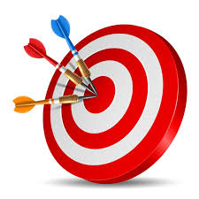
Objective
Develop a real-time hand gesture recognition system using OpenCV and MediaPipe
Detect and extract 21 hand landmarks from live webcam input
Compute a hand bounding box using coordinate extrema
Implement finger counting logic using landmark position comparison
Map finger-count gestures to media control actions
Integrate PyAutoGUI to simulate keyboard inputs
Implement debounce logic to prevent repeated triggering
Optimize the system for stable real-time performance

Slide 8
System Architecture
Web Cam
Content :
Webcam captures real-time video stream
MediaPipe detects 21 hand landmarks
OpenCV processes frame and extracts coordinates
Finger counting logic interprets gestures
PyAutoGUI triggers keyboard-based media actions
Debounce mechanism ensures stable interaction
MediaPipe
OpenCV Processing
Gesture Logic
PyAutoGUI
YouTube

Slide 9
Methodology
Capture live video frames using OpenCV
Convert frame to RGB for MediaPipe processing
Detect hand landmarks
Extract landmark coordinates
Compute bounding box
Apply finger counting logic
Map gesture to action
Apply debounce logic

Slide 10
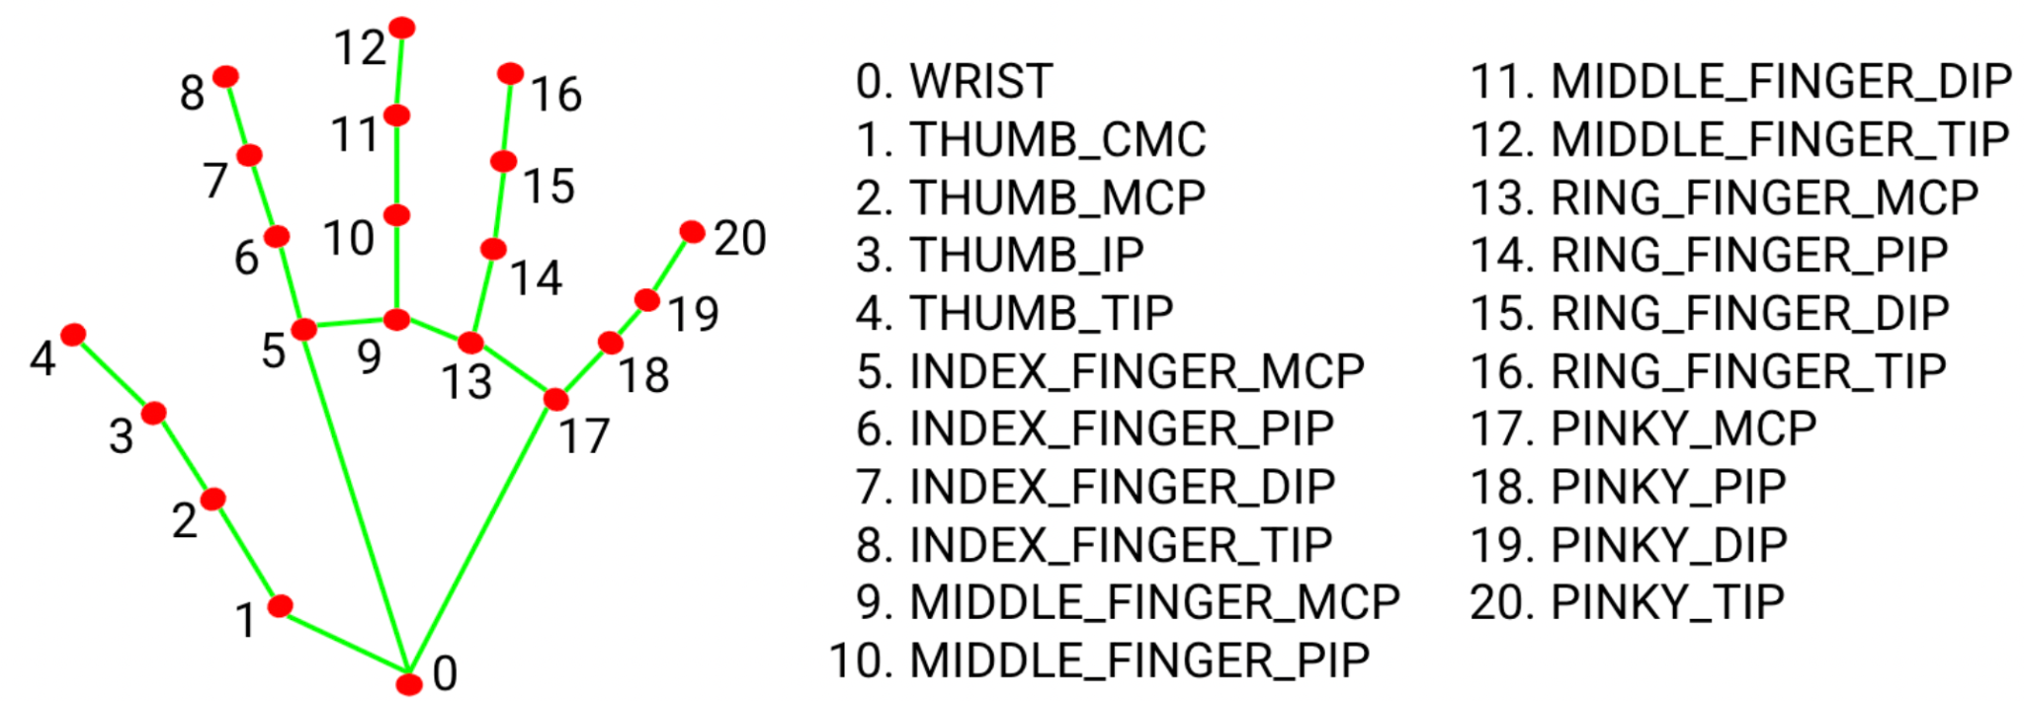
Hand Landmark Detection
MediaPipe detects 21 key hand points
Each landmark provides normalized (x, y) coordinates
Coordinates converted to pixel values
Used for gesture computation

Slide 11
Finger Counting Logic
Thumb detected using horizontal comparison
Other fingers detected using vertical comparison
Compare fingertip with lower joint landmark
Count number of raised fingers
totalFingers = fingers.count(1)

Slide 12



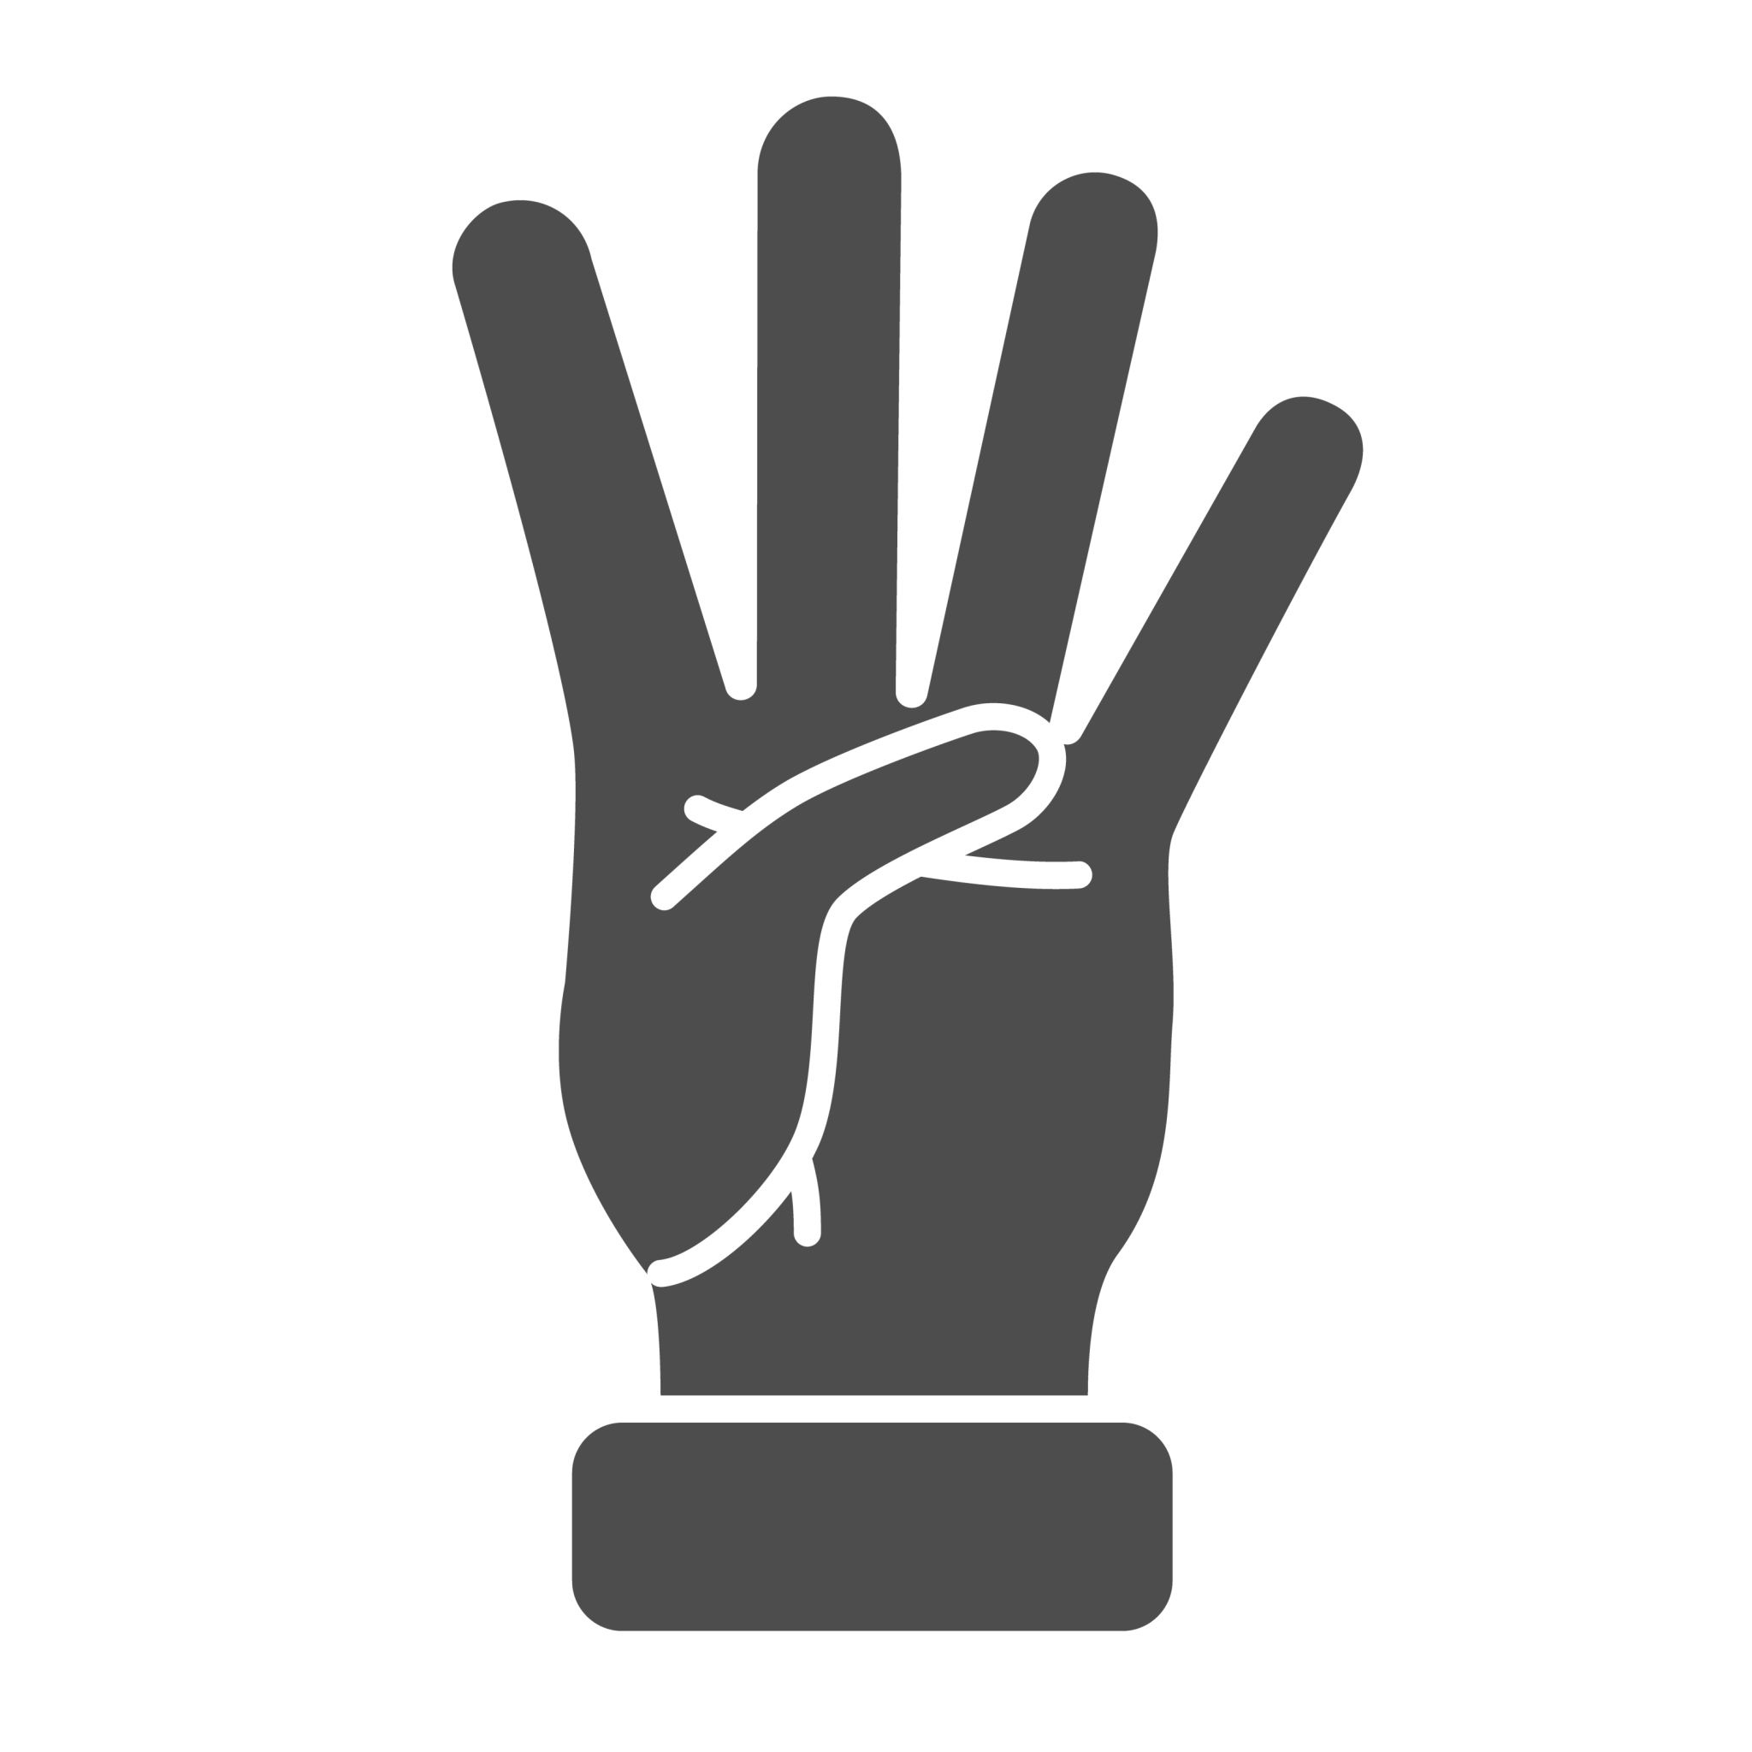


Gesture to Action Mapping
:
Finger | Action
1 | Fullscreen
2 | Forward
3 | Backward
4 | Volume Up
5 | Play / Pause
0 | Volume Down

Slide 13
Results
Real-time gesture-controlled YouTube playback
Stable performance on CPU
Accurate finger detection
Smooth interaction experience

Slide 14
Future Enhancements
Two-hand gesture support
Custom gesture configuration
ML-based gesture classifier
Integration with smart home systems

Slide 15
Conclusion
Successfully developed a real-time hand gesture recognition system using OpenCV and MediaPipe
Accurately detected and processed 21 hand landmarks from live webcam input
Implemented reliable finger counting logic for gesture interpretation
Mapped gestures to YouTube media control actions using PyAutoGUI
Integrated a debounce mechanism to ensure stable and smooth interaction
Achieved efficient performance on a CPU-only system using standard webcam hardware
Demonstrated practical application of computer vision in human-computer interaction
Notes:
textbox
No alt text provided
textbox
No alt text provided
textbox
No alt text provided
textbox
No alt text provided
textbox
No alt text provided
textbox
No alt text provided
textbox
No alt text provided
textbox
No alt text provided
actionButton
No alt text provided

Slide 16
?
Any
Questions

Slide 17

Thank you

